Slide 1

SANJAY GHODAWAT UNIVERSITY
Kolhapur
Established under section 2(f) of UGC Act 1956
Sanjay Ghodawat University Act XL of 2017 of Govt. Maharashtra Approved by PCI, COA & AICTE
PROJECT PRESENTATION
On
“Restaurant Billing System”
By
Name- Omkar Vinod Gurav (PRN No) 22SC114281061
Name- Parth Rajendra Medhekar (PRN No) 22SC114281060
Name- Vedant Maruti Narote (PRN No) 22SC114281063
Name- Pratik Satish Shinde (PRN No) 22SC114281065
Under supervision
of
Mr. Sanket S Prabhu
Program : Btech Class : FY BTech
School of Computer Science and Engineering
A.Y 2022-23

Slide 2
Introduction
The “Restaurant Billing System” or “RBS” is an application to automate the process of information recording and billing of a restaurant. This desktop based application is designed to administer its users and customers.
RBS is a billing system, made for the effective utilization of modern technology in the organization.
It is an automated software that can handle a lot of information about the restaurant’s employees, order history, reservation data.
It has the capability to process bills and gather information about its employees and billing history.
It is designed for the sole purpose of efficiency, speed and accuracy.
Waterfall Model is used to develop this software where different requirements are identified at first, analyze the requirements then design the software using various tools and techniques and using the development language the software is developed.
Different testing like unit testing and integration testing are done during the development process.

Slide 3
Problem definition
The billing process is done manually by manpower. It results in delayed time for the consumer and to the organization while the bill is being processed. So, there is a room for improvement here. A certain computer based billing system could aid the organization to utilize its resources better. The currently used system contains the following problems which are listed below:
Inability of modification of data
Manual operator control
Lots of paperwork 4
Difficult to record information systematically
Difficult to retrieve information in time
Wastage of paper Based on the given problems, management of the information and billing process can be more efficient with the help of RBS.

Slide 4
Objectives
To add and maintain records of available menu.
To add and maintain employee details.
To add and maintain description of new menu.
To provide view of transaction to the owner.
To provide a convenient solution of billing pattern.
To make an easy to use environment for users.
Easy to use system.

Slide 5
Scope
The software has a lot of features and advantages over the paper based billing system. It has the following scopes:
This project will help the employee in fast billing.
The project will enable to see free reservation available.
Quality and faster service can be given to the customers.
Easy to maintain in future prospect.
This project enable employees to maintain a great database of information regarding the billing and reservation.

Slide 6
Problem identification
Workload Intensive Process.
Unnecessary Costs of Process.
Delays In Process.
Hampered Productivity.
Delayed transactions.
Consumed much time for calculation

Slide 7
System requirement specification
• SOFTWAREREQUIREMENTS o
Dev C++
• HARDWAREREQUIREMENTS
o 4GBRAM o 500GBHDD o i3processor

Slide 8
Flowchart
START
SELECT YOUR PREFERED OPERATIOM
Enter Customer name
ENTER NUMBER OF ITEMS
ENTER ITEM NAME
ENTER ITEM QUANTITY
ENTER UNIT PRICE
GENERATE BILL
PRESS Y TO SAVE INVOICE
PRESS N TO END
Y
INVOICE SAVED
Y
DO YOU WANT TO OPERATE AGAIN
N
END

Slide 9
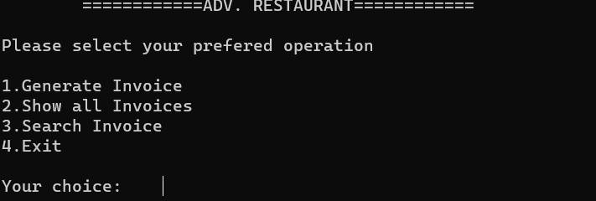
Output design
1 MAIN OUTPUT (FIRST PAGE)
PROGRAM IS ENDED WITH DISPLAYING THE ACCURATE TIME SPENT WITH ONE CUSTOMER IS DISPLAYED AND IF THE BILL ARE SAVED THEN THOSE CAN ALSO BEEN SEEN .

Slide 10
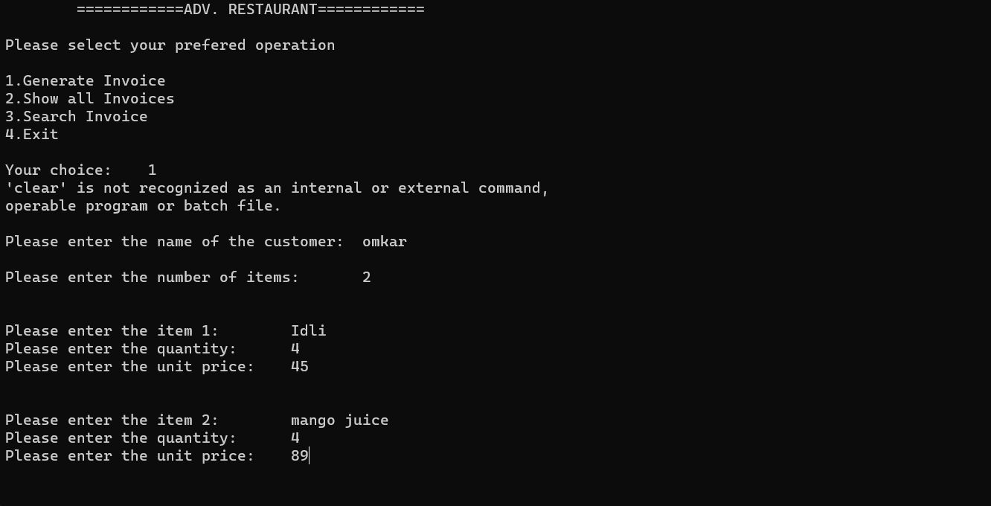
Output Design
2 WHEN YOU CHOOSE 1 IT WILL GENERATE INVOICE

Slide 11
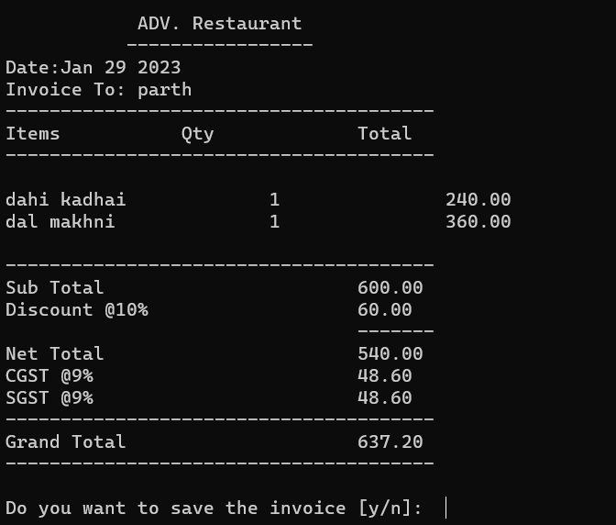
Output Design
3 WHEN YOU ENTER THE ITEM DETAILS THEN THE BILL WILL BE GENERATED

Slide 12
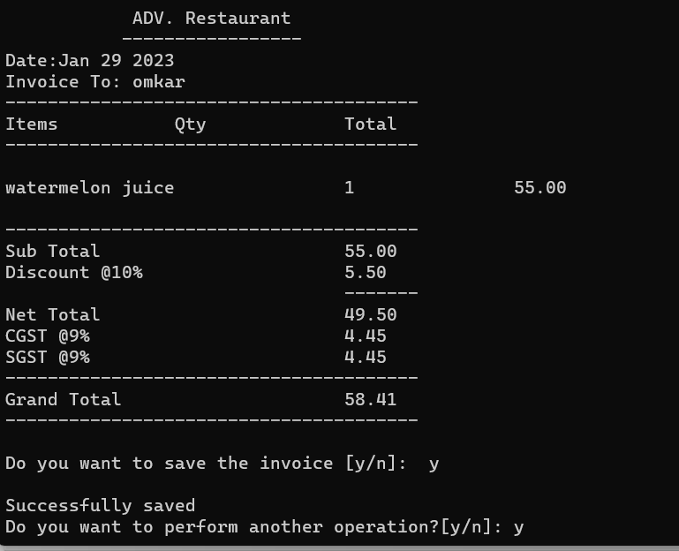
Output Design
IF YOU WANT TO SAVE TYPE Y AND AGAIN IF YOU WANT TO PERFORM ANOTHER OPERATION THEN TYPE (Y,N)

Slide 13
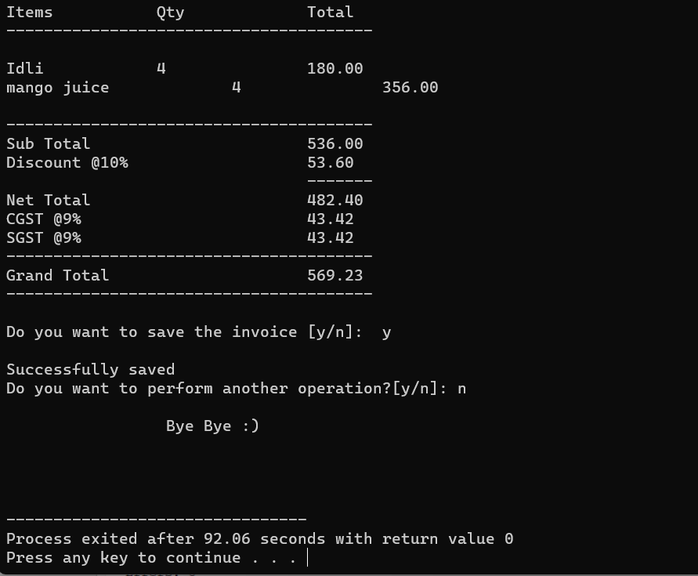
Output Design
5 IF TYPED N THEN BILL WILL BE GENERATED AND PROGRAM WILL END
PROGRAM IS ENDED WITH DISPLAYING THE ACCURATE TIME SPENT WITH ONE CUSTOMER IS DISPLAYED AND IF THE BILL ARE SAVED THEN THOSE CAN ALSO BEEN SEEN .

Slide 14
Advantages
Easy to write. ...
Low cost. ...
Fast execution speed. ...
Portable. ...
Easy debugging. ...
Procedure Oriented Language. ...
Speed of Compilation. ...
Execution of algorithms and data structures

Slide 15
Future scope
RBS software offers various functionalities needed to effectively manage restaurant operations such as
staff management
making orders
billing
menu management reservation
viewing order history, to-do list and many more. In the future, many
enhancements/upgrades can be made to the existing software.
Various enhancements such as inventory management and control,
wireless table side ordering and payment,
online ordering
mobile management capabilities can help increase revenue and cut cost.

Slide 16
Conclusion
The documentation includes all necessary information on the structure and the coding of the program created for Restaurant Billing system. Creating the program was an overwhelming task that required a lot of analyzing, research work and personal skills.
Creating this report has been a great experience and numerous facts have been learned since the required tasks were very challenging.
Tasks such as creating a system to a restaurant, needed research work as well as personal skills. Creating proper design and smooth flow of operation was a very tiring task that consumed a lot of time.
The program has been created successfully with proper design and working flow of operation.
The billing part was the most important and difficult part of this project. Retrieving data from database for the billing purpose was quite a tough task. Making changes on multiple data base using SQL queries was also a bit time consuming and though provoking task.
In conclusion, many experiences have been gained specially in coding. Time management and teamwork is very important in the development system.

Slide 17
References
Websites:
1. https://youtu.be/_2msghvRn5M
Books:
Practical C Programing
C Project with cd 1 edition

Slide 18
Thank You

